Slide 1

Get Started with Spring Boot

Slide 2
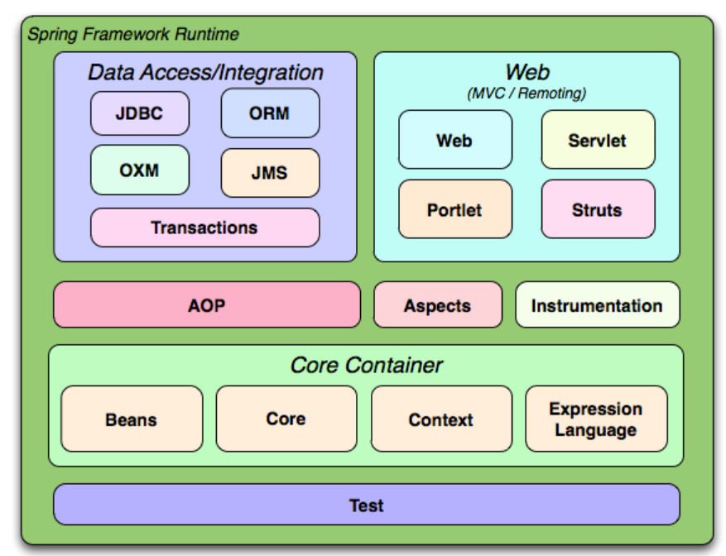
What is Spring?
The Spring Framework provides a comprehensive programming and configuration model for modern Java-based enterprise applications - on any kind of deployment platform.
It's packed with some out of the box modules like:
Spring JDBC
Spring MVC
Spring Security
Spring AOP
Spring ORM
Spring Test
https://docs.spring.io/spring-framework/docs/3.2.x/spring-framework-reference/html/overview.html
Notes:
Spring Framework is a Java platform that provides comprehensive infrastructure support for developing Java applications. Spring handles the infrastructure so you can focus on your application.
Java Database Connectivity
A key element of Spring is infrastructural support at the application level: Spring focuses on the "plumbing" of enterprise applications so that teams can focus on application-level business logic, without unnecessary ties to specific deployment environments
AOP (Aspect Oriented Programming)
More information can be found https://docs.spring.io/spring-framework/docs/3.2.x/spring-framework-reference/html/overview.html

Slide 3
What is Spring Boot?
Spring Boot is basically an extension of the Spring framework, which eliminates the boilerplate configurations required for setting up a Spring application.
https://www.baeldung.com/spring-vs-spring-boot
Notes:
Here are just a few of the features in Spring Boot:
Opinionated ‘starter' dependencies to simplify the build and application configuration
Embedded server to avoid complexity in application deployment
Metrics, Health check, and externalized configuration
Automatic config for Spring functionality – whenever possible

Slide 4
Why Spring Boot?
https://medium.com/@2019ruwan/spring-boot-01-dependency-injection-afea8fa891c0

Slide 5
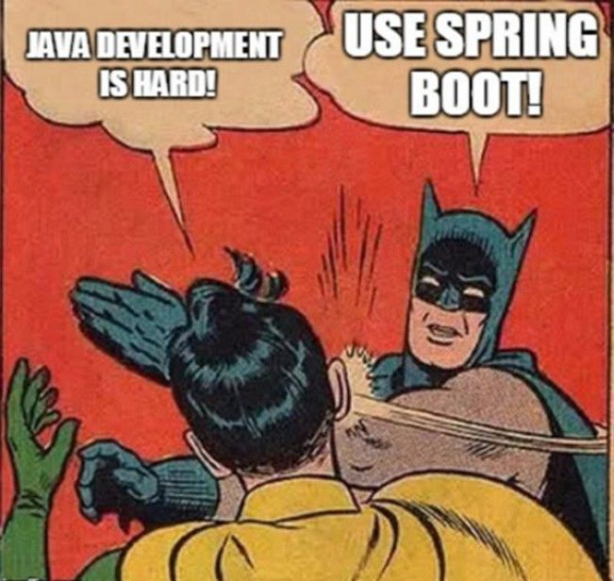

Slide 6
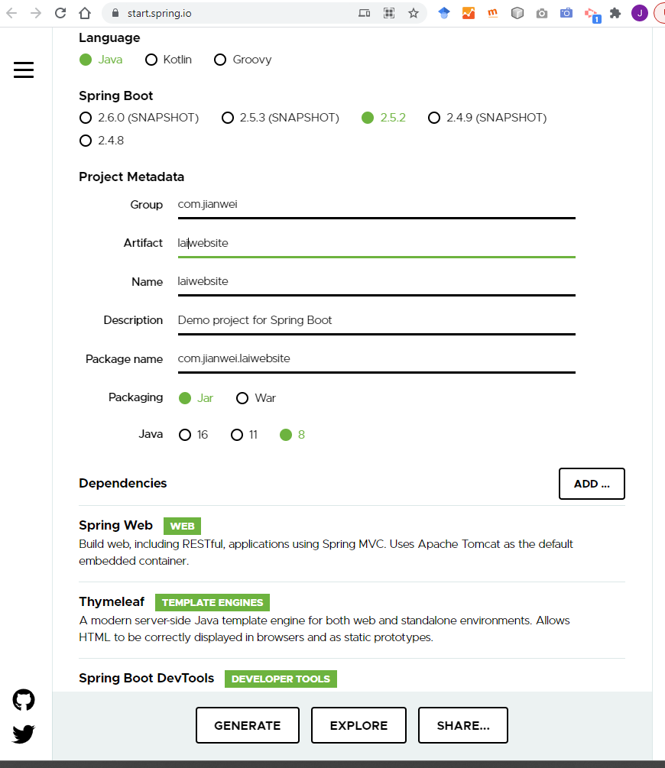
An example-Build an application with Spring Boot
Create a project with Spring Initializr https://start.spring.io/
Click generate
https://spring.io/guides/gs/serving-web-content/
Notes:
The Spring Boot Maven Plugin provides Spring Boot support in Apache Maven. It allows you to package executable jar or war archives, run Spring Boot applications, generate build information and start your Spring Boot application prior to running integration tests. https://docs.spring.io/spring-boot/docs/current/maven-plugin/reference/htmlsingle/
1.0.0 SNAPSHOT those releases are still been built, replacing earlier snapshots of the same version
M- milestone
Group denotes the package
Artifact denotes the Application name

Slide 7
Maven
Apache Maven is a software project management and comprehension tool. Based on the concept of a project object model (POM), Maven can manage a project's build, reporting and documentation from a central piece of information.
https://maven.apache.org/

Slide 8
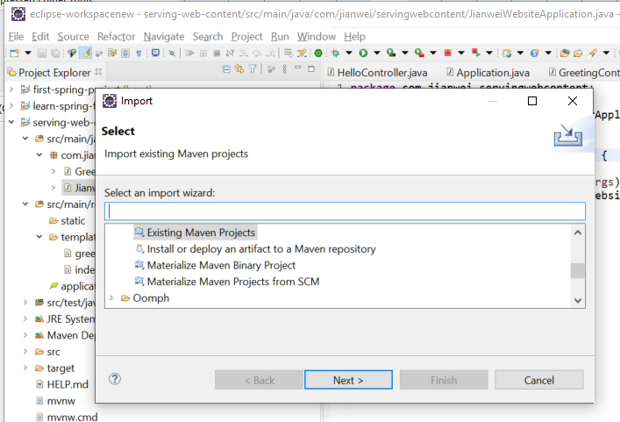
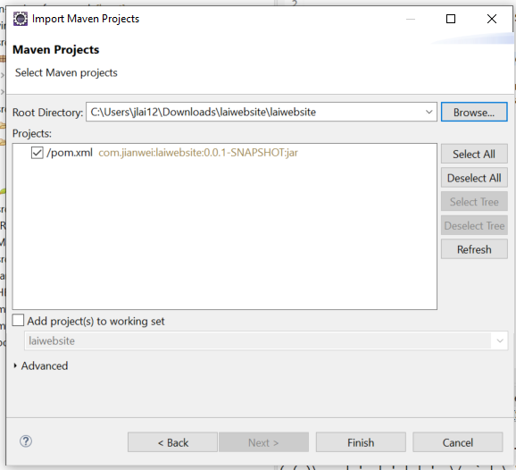
Import project to Eclipse: File->Import->Existing Maven Projects
https://spring.io/guides/gs/serving-web-content/

Slide 9
classpaths
By default, Spring Boot will serve static content from a directory called
/static
or /public
or /resources
or /META-INF/resources in the classpath
https://docs.spring.io/spring-boot/docs/current/reference/html/features.html#features.developing-web-applications
Notes:
or from the root of the ServletContext
Servlet Context:
It is initialized when a Servlet application is deployed. Servlet Context holds all the configurations (init-param, context-params, etc) of the whole servlet application.

Slide 10
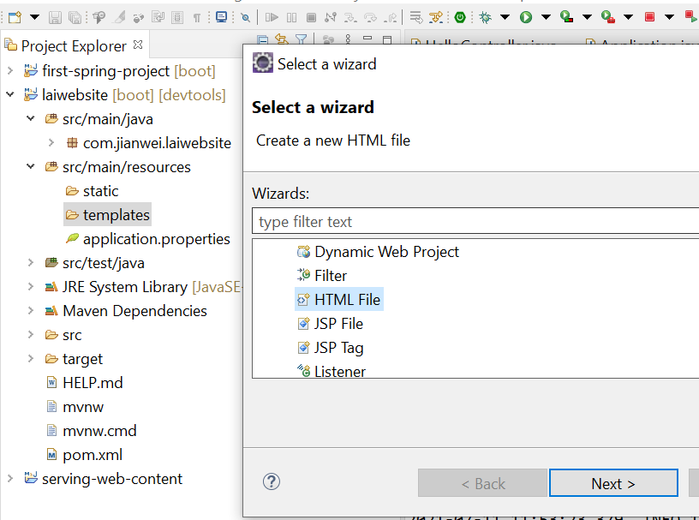
Default Thymeleaf folder in Spring Boot
Notes:
These files are from Maven wrapper. It works similarly to the Gradle wrapper.
This allows you to run the Maven project without having Maven installed and present on the path. It downloads the correct Maven version if it's not found (as far as I know by default in your user home directory).
The mvnw file is for Linux (bash) and the mvnw.cmd is for the Windows environment.

Slide 11
Add a HTML file to the Templates folder

Slide 12
thymeleaf
<!DOCTYPE HTML>
<html xmlns:th="http://www.thymeleaf.org">
<head>
<title>Getting Started: Serving Web Content</title>
<meta http-equiv="Content-Type" content="text/html; charset=UTF-8" />
</head>
<body>
<p th:text="'Hello, ' + ${name} + '!'" />
</body>
</html>
Notes:
The @GetMapping annotation ensures that HTTP GET requests to /greeting are mapped to the greeting() method.
@RequestParam binds the value of the query string parameter name into the name parameter of the greeting() method. This query string parameter is not required. If it is absent in the request, the defaultValue of World is used. The value of the name parameter is added to a Model object, ultimately making it accessible to the view template.
In web applications Thymeleaf aims to be a complete substitute for JavaServer Pages (JSP), and implements the concept of Natural Templates: template files that can be directly opened in browsers and that still display correctly as web pages. Thymeleaf is Open-Source Software, licensed under the Apache License 2.0.
https://en.wikipedia.org/wiki/Thymeleaf#:~:text=In%20web%20applications%20Thymeleaf%20aims,under%20the%20Apache%20License%202.0.
JSP IS OUTDATED

Slide 13
thymeleaf
Thymeleaf is a Java library.
It is an XML/XHTML/HTML5 template engine able to apply a set of transformations to template files in order to display data and/or text produced by your applications.
The main goal of Thymeleaf is to provide an elegant and well-formed way of creating templates.
https://www.thymeleaf.org/doc/tutorials/2.1/usingthymeleaf.html

Slide 14
Add a Web Controller
@Controller
public class GreetingController {
@GetMapping("/greeting")
public String greeting(@RequestParam(name="name", required=false, defaultValue="World") String name, Model model) {
model.addAttribute("name", name);
return "greeting";
}
}
Notes:
The @GetMapping annotation ensures that HTTP GET requests to /greeting are mapped to the greeting() method.
@RequestParam binds the value of the query string parameter name into the name parameter of the greeting() method. This query string parameter is not required. If it is absent in the request, the defaultValue of World is used. The value of the name parameter is added to a Model object, ultimately making it accessible to the view template.

Slide 15
@Controller
The @Controller annotation is a specialization of the generic stereotype @Component annotation, which allows a class to be recognized as a Spring-managed component.
Controller acts on both model and view. It controls the data flow into model object and updates the view whenever data changes. It keeps view and model separate.
https://stackabuse.com/controller-and-restcontroller-annotations-in-spring-boot/
https://www.tutorialspoint.com/design_pattern/mvc_pattern.htm
Notes:
Model---related to data
View—related to what you see
Control—control the data flow

Slide 16
@GetMapping("/greeting")
text in the url
@GetMapping("/greeting")
public String greeting(@RequestParam(name="name", required=false, defaultValue="World") String name, Model model) {
model.addAttribute("name", name);
return "greeting";
}
}
Return html page in the templates folder
@RequestParam to extract query parameters, form parameters, and even files from the request
Notes:
https://www.baeldung.com/spring-request-param

Slide 17
HTTP Methods
GET
POST
PUT
HEAD
DELETE
PATCH
OPTIONS
https://www.w3schools.com/tags/ref_httpmethods.asp

Slide 18
GET
GET requests should never be used when dealing with sensitive data
ET requests have length restrictions
GET requests are only used to request data (not modify)
GET requests can be cached
GET requests remain in the browser history
GET requests can be bookmarked
/test/demo_form.php?name1=value1&name2=value2

Slide 19
POST
The data sent to the server with POST is stored in the request body of the HTTP request:
Some other notes on POST requests:
POST requests are never cached
POST requests do not remain in the browser history
POST requests cannot be bookmarked
POST requests have no restrictions on data length
POST /test/demo_form.php HTTP/1.1 Host: w3schools.com name1=value1&name2=value2

Slide 20
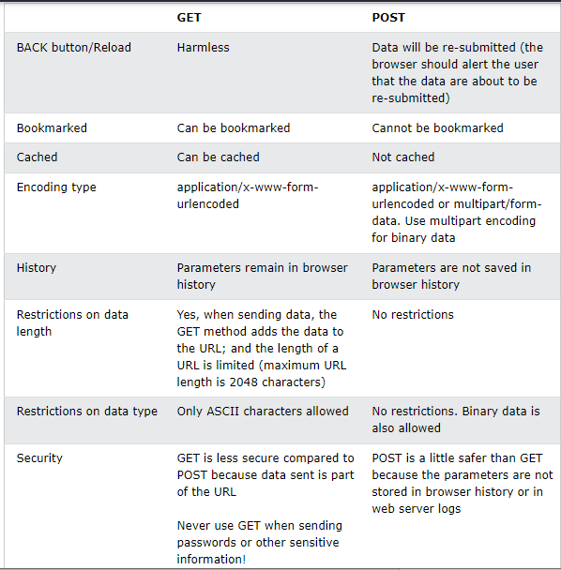
GET vs POST
https://www.w3schools.com/tags/ref_httpmethods.asp

Slide 21
PUT, HEAD, DELETE, OPTIONS
PUT- is used to send data to a server to create/update a resource.
HEAD is almost identical to GET, but without the response body.
The DELETE method deletes the specified resource.
The OPTIONS method describes the communication options for the target resource.
https://www.w3schools.com/tags/ref_httpmethods.asp

Slide 22
Mapping
@GetMapping
@PostMapping
@RequestMapping
@RequestMapping(value = "/users/{id}", method = RequestMethod.GET)
@GetMapping("/users/{id}")
https://howtodoinjava.com/spring5/webmvc/controller-getmapping-postmapping/
Notes:
Originally, Spring had only @RequestMapping annotation for mapping the request URI and HHTP method type. Spring 4.3 introduced five new more specific annotations for each HTTP request type.
@GetMapping
@PostMapping
@PutMapping
@DeleteMapping
@PatchMapping
The two mapping do the same thing

Slide 23
@PostMapping
@PostMapping acts as a shortcut for @RequestMapping(method = RequestMethod.POST)
@RequestMapping(value = "/employees", method = RequestMethod.POST) @PostMapping("/employees")
https://howtodoinjava.com/spring5/webmvc/controller-getmapping-postmapping/

Slide 24
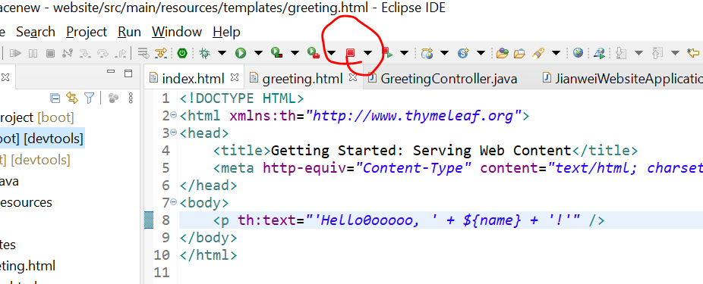
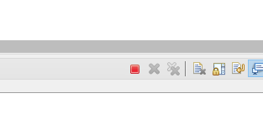
The server issue-Stop the running Application
Description:
Web server failed to start. Port 8080 was already in use.
Action:
Identify and stop the process that's listening on port 8080 or configure this application to listen on another port.
Notes:
If you cannot find it on the top to terminate the application, check the console

Slide 25
Try
localhost:8080/index
localhost:8080/index/?name=jianwei
The ip assigned to you
Notes:
If there is another index page in the static folder
Which page will be shown with localhost:8080
static > templates

Slide 26
Try
@GetMapping({“index”, “/”})
localhost:8080/
localhost:8080/index

Slide 27
Where can we add a css file for the index page?
Notes:
In static
<link rel=“stylesheet” href=“/css/index.css”>
<link rel=“stylesheet” href=“../css/index.css”>

